Slide 1
Linking Structure to the Dynamics of Collective Learning

Slide 2
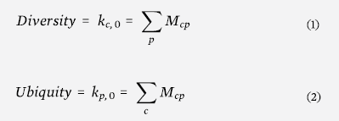
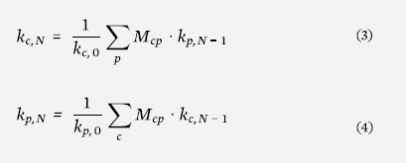
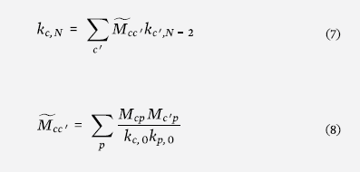
Calculating productive knowledge
We calculate the second eigenvector
We can do the same for products
where

Slide 3
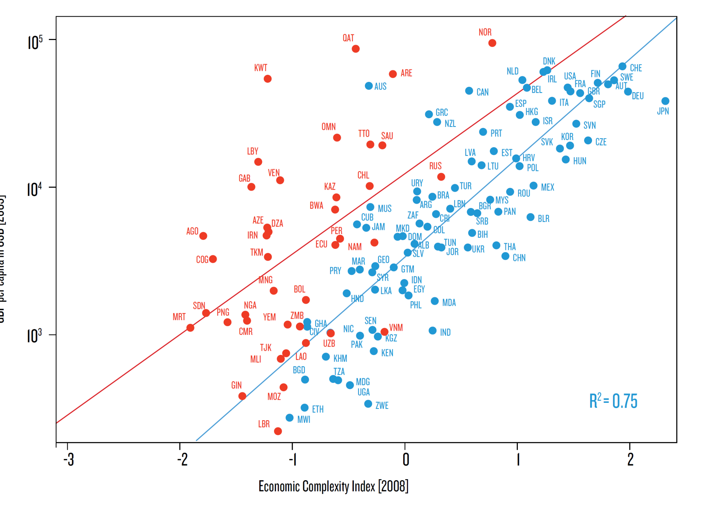
ECI correlates with GDP per capita
Countries with Natural Resource
Exports>10% of GDP
Income Per Capita
Countries with Natural Resource
Exports<10% of GDP
Economic Complexity

Slide 4
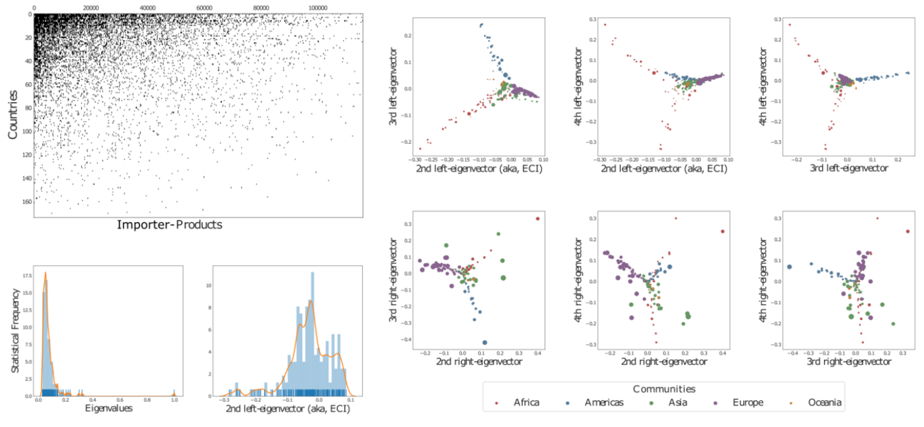
Eigenspaces: left and right

Slide 5
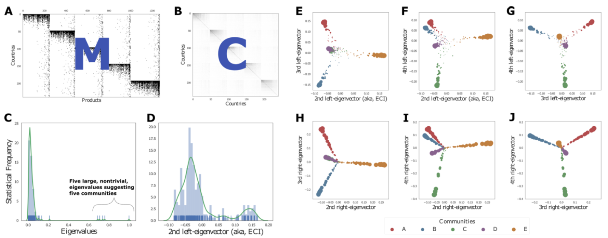
Toy world

Slide 6
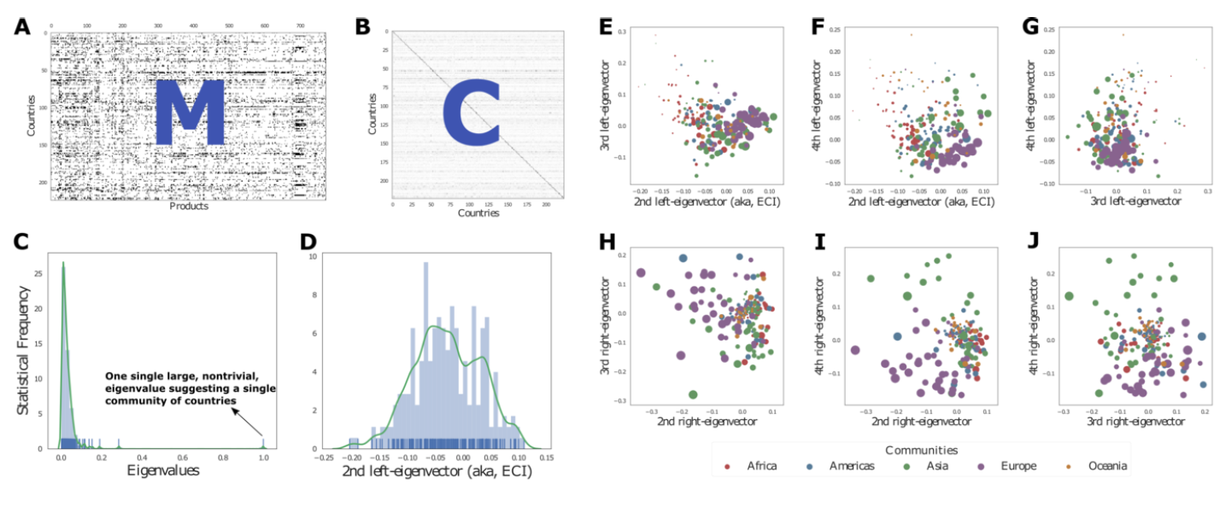
Real exporter-product

Slide 7
Growth is the consequence of both
An “absolute effect” (how much you know)
A “relative effect” (how much others ahead of you know)

Slide 8
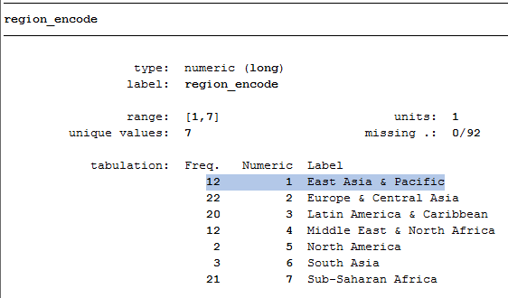
Regressions
On levels:
Year=2005
Region fixed-effects:
reference

Slide 9
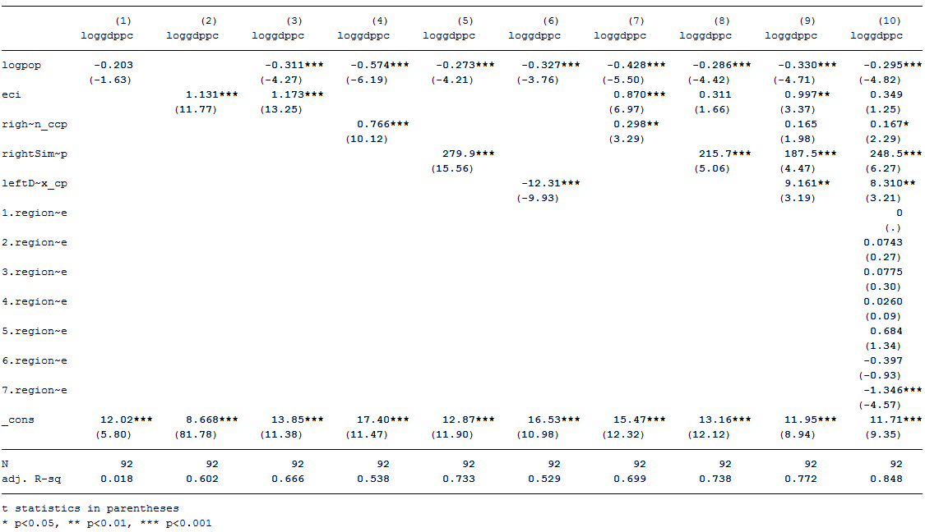
Regressions on levels (year 2005)

Slide 10
avplots

Slide 11
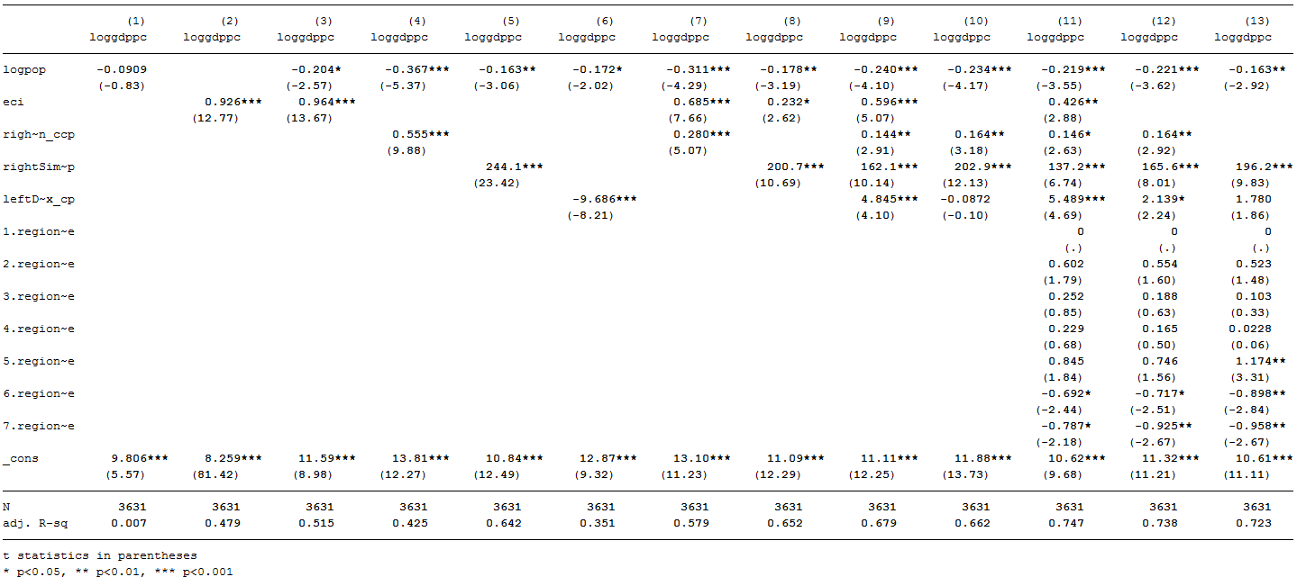
All years – but clustering by country

Slide 12
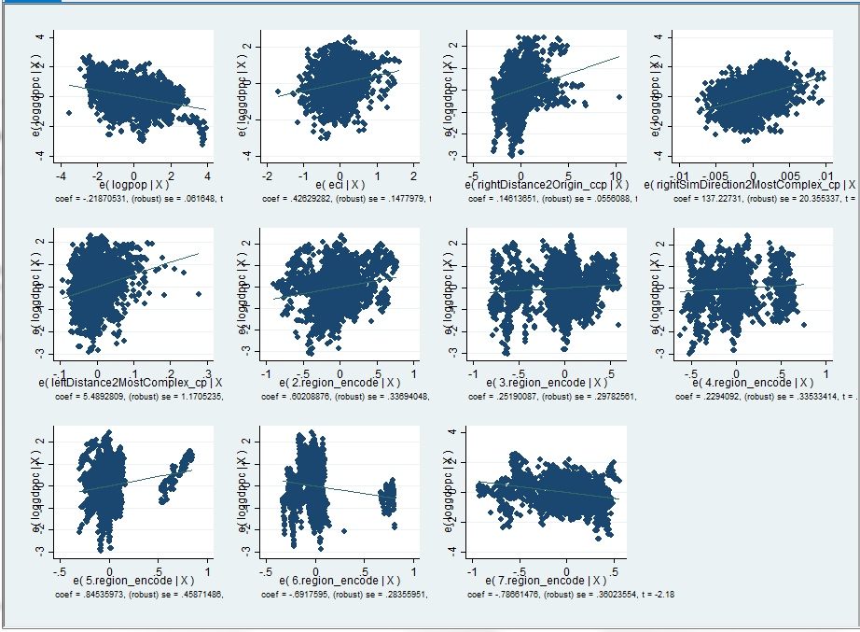

Slide 13
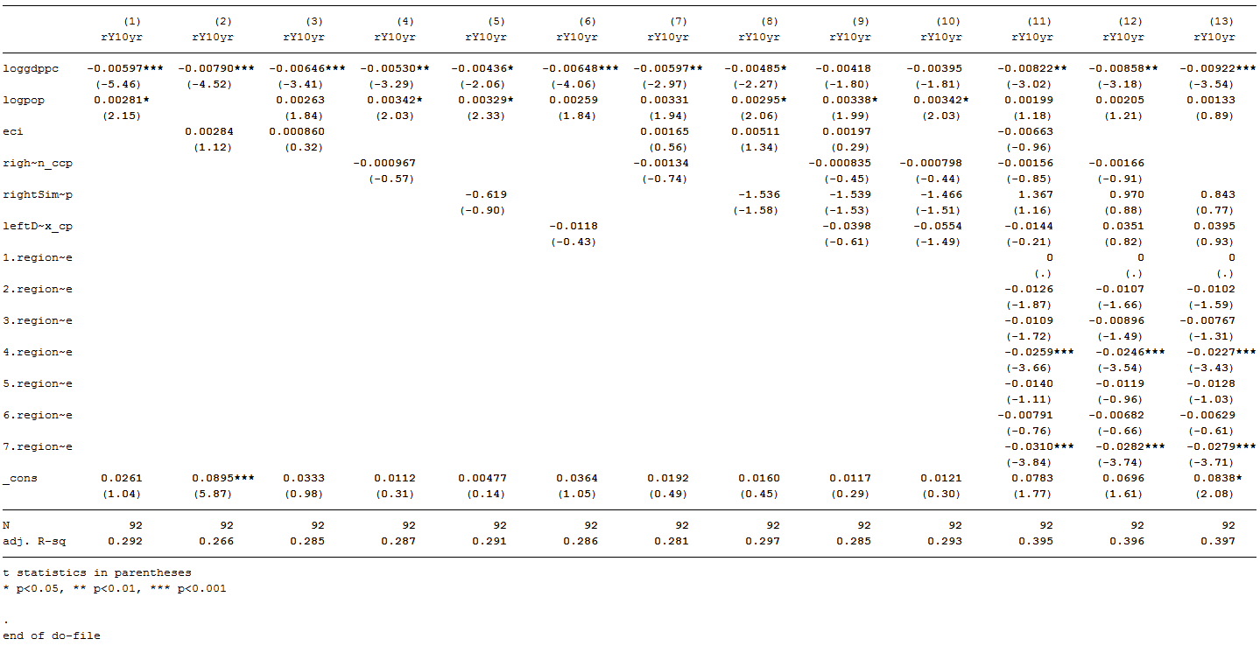
Regressions on GDPpc growth in 2005-2015

Slide 14
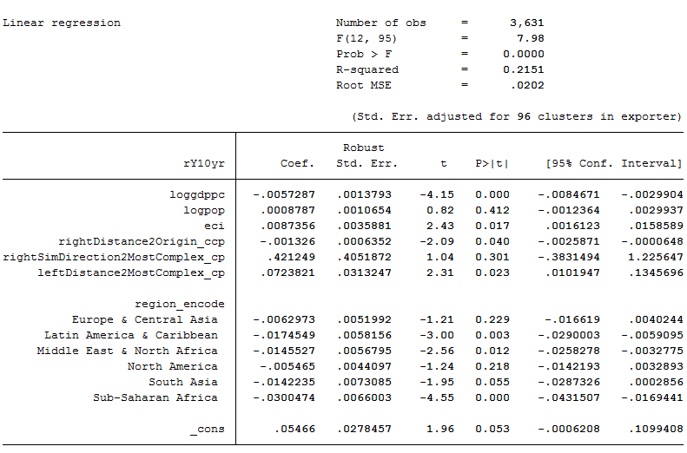
Regressions on GDPpc growth allyears + cluster by country

Slide 15
